Slide 1
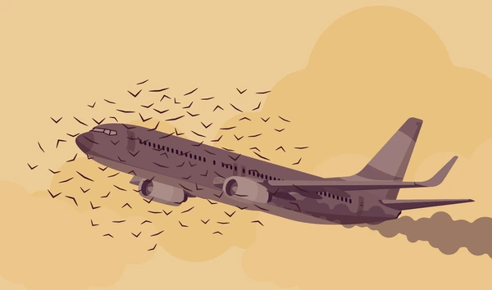
BIRD STRIKES BETWEEN 2000 – 2011

Slide 2
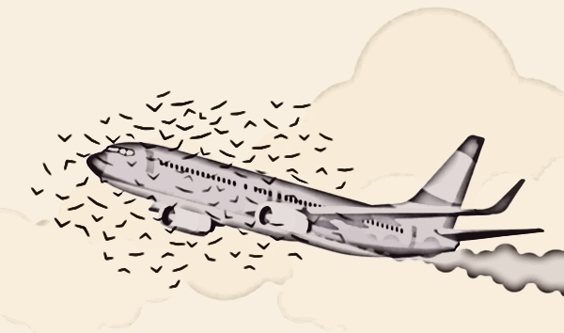

INTERNSHIP DONE UNDER
DATA ANALYST
Presented By : Akshay Hosurkar

Slide 3

Objective: Analyzing incidents of bird strikes on aircraft between 2000 and 2011.
Focus: Understanding the impact of bird strikes on flight safety and operations.
Tool Used: Power BI for data analysis and visualization.

Slide 4
Key Metrics
Total Bird Strikes: 25.43K
Total Cost of Rebuilding: $142M
Average Altitude: 799.03 feet
Percentage of Bird Strikes Below 1000 ft: 87%
Bird Strikes Causing Damage: 90.35%

Slide 5
Yearly Trends
Highest Number of Bird Strikes: 2011 with 7.7K incidents
Highest Cost of Rebuilding: 2003 with $23.3M
Significant Decrease: From 2003 to 2005 (23M to 7M)

Slide 6
Bird Strike by Altitude
The data reveals that the vast majority of bird strikes, 87.11%, occurred at altitudes below 1000 feet, highlighting the vulnerability of aircraft during take-off and landing phases.
Only 12.89% of bird strikes occurred at altitudes above 1000 feet, suggesting that high-altitude flights are relatively safer in this context.

Slide 7
Damage Caused by Bird Strikes
A large portion of bird strikes, 90.35%, resulted in no significant damage to the aircraft, but 9.65% of incidents caused damage, requiring costly repairs and sometimes emergency measures.
The data suggests that while many bird strikes don’t cause harm, those that do have a substantial financial and operational impact on airlines.

Slide 8
Top Airlines Affected
Southwest Airlines and American Airlines were the top two airlines most affected b bird strikes, each reporting over 9K incidents.
Other heavily impacted airlines include Delta Air Lines with 6.1K bird strikes, followed by US Airways and United Airlines, showing the widespread nature of this issue across major carriers.

Slide 9
Bird Strikes by Weather Conditions
Fog and rain were the most common weather conditions associated with bird strikes, contributing to 4.7K incidents.
Other significant conditions included combinations of fog, snow, and rain, which also resulted in high occurrences of bird strikes, indicating that poor visibility and weather factors greatly increase risk .

Slide 10
Flight Phases Affected by Bird Strikes
The approach phase of flight saw the highest number of bird strikes, with 25K incidents, followed closely by take-off and climb phases, which highlights the danger zones for aircraft during specific flight stages.
Very few bird strikes occurred during the taxiing or parked phases, where aircraft movement is minimal.

Slide 11
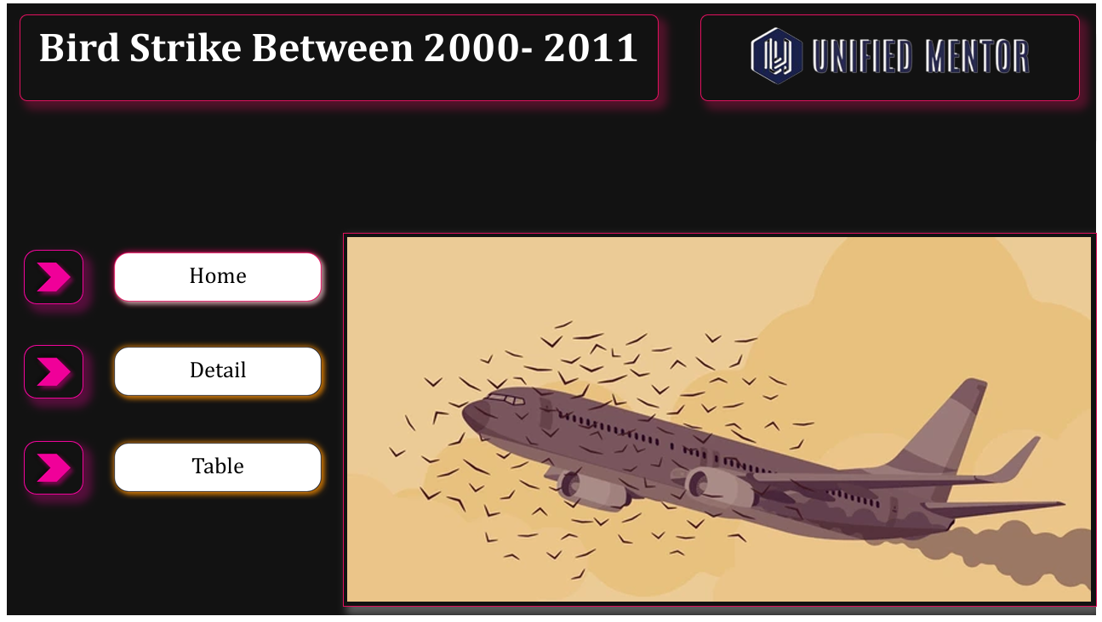
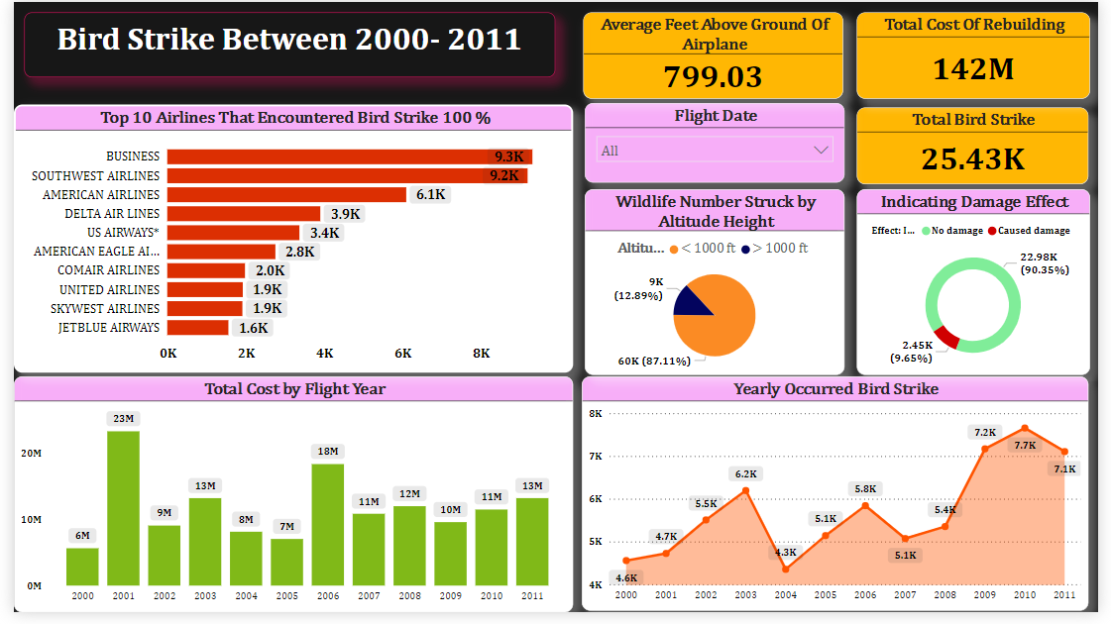
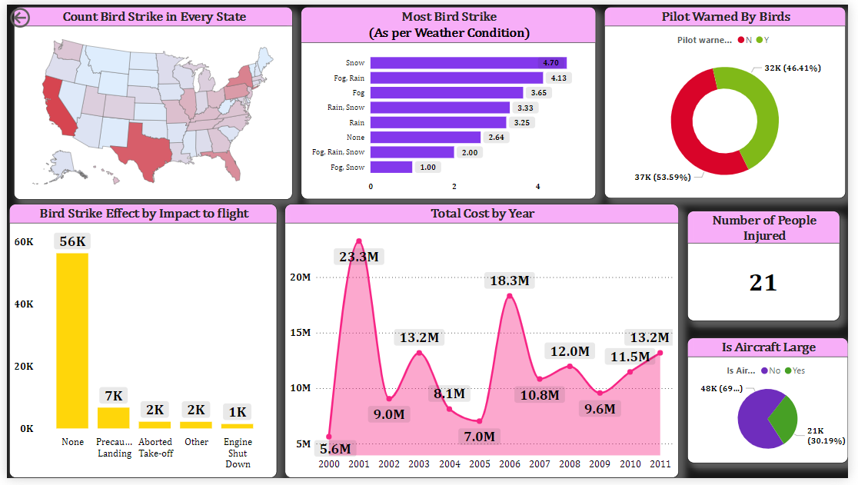
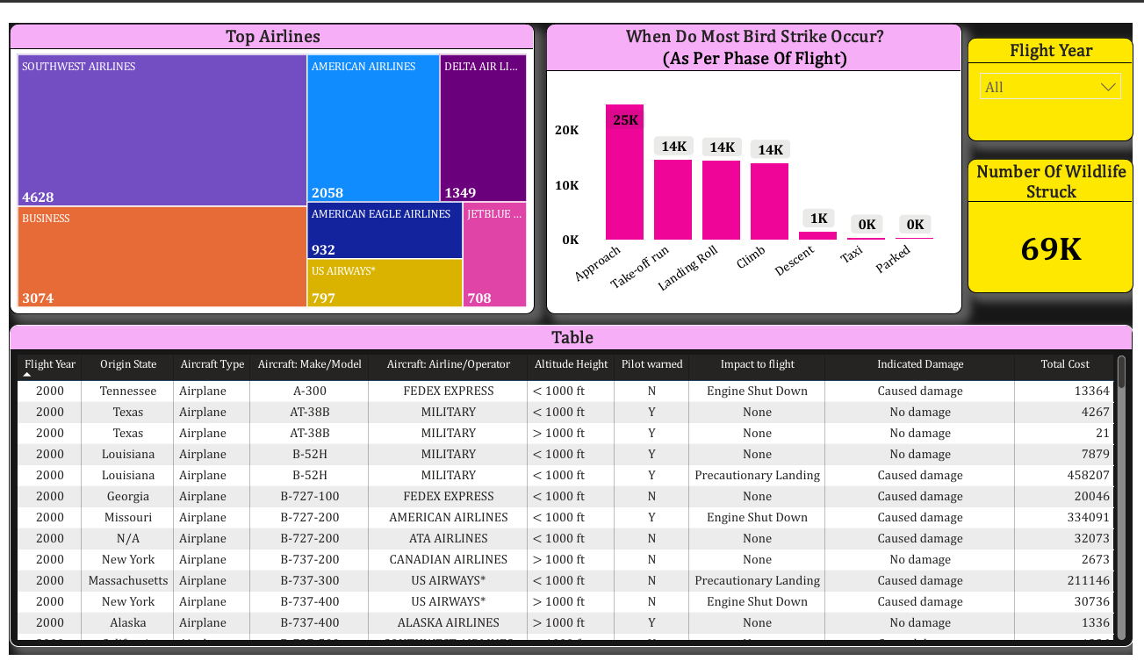
Mock Up Dashboard
Home
Details
Table

Slide 12
Thank You

